Slide 1



Scheduling Algorithm Research:
Fleet maintenance optimisation
Data7902 Capstone Project
Presenter: David Long

Slide 2

The aircraft maintenance scheduling problem
In aviation, aircraft needs to go through routine checks. Multiple aircraft can go through routine checks concurrently.
Concurrent maintenance creates dips in fleet availability. Staggered checks must preserve start windows and maintenance rules.
Finite resources such as dock space, mechanics, and components.
First: maximise worst-day availability.
Then: reduce standard deviation.

Slide 3



Simple fleet proof of concept
10 aircraft, 80 checks. Keep the best feasible improvement at each iteration.

Slide 4


The heavy maintenance forecast
24 aircraft and 278 checks
A, B, C and D maintenance checks
Sequence: A B A C A B A D
12-year forecast

Slide 5

Scaling the search: Random Sampling method
The heavy fleet creates over 1,000 neighbours per iteration.
Full evaluation becomes too slow.
Sampling 200 neighbours reduces work.
Not deterministic, only reproducible with same seed
Random selection can miss a useful move.

Slide 6
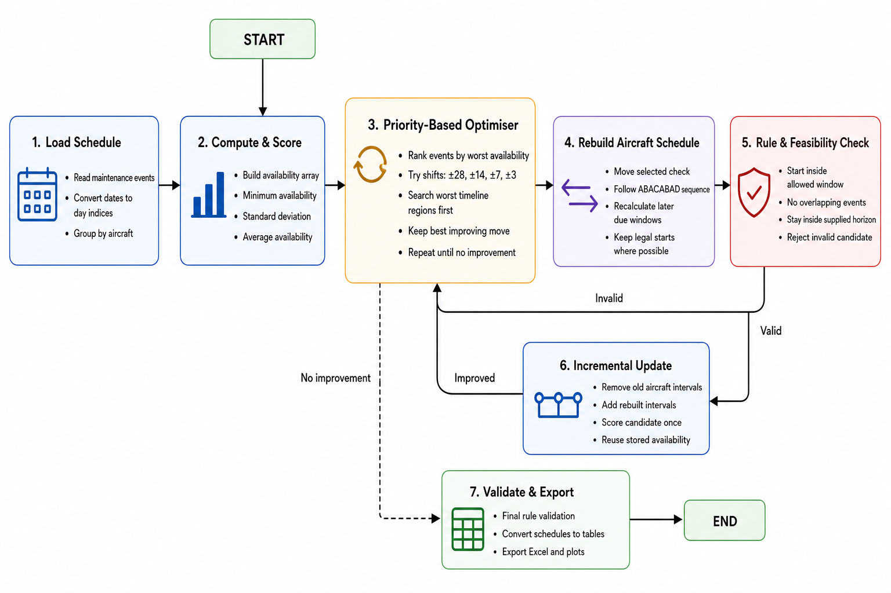
PRIORITY BASED SELECTION WITH VARIABLE NEIGHBOURHOOD SEARCH
Priority selection searches the worst availability regions first
Rank events by the worst availability during their interval.
Search the worst priority level first, expand only if needed.
Move one check, then rebuild later events using A/B/C/D rules.
Update incrementally and score once.
Deterministic, rule-compliant, and substantially faster.
Measured result: min 15→18, std 1.96→1.44.

Slide 7
Each event gets one priority: the worst day it covers
From the heavy starting schedule: global min availability = 15, 278 events, 24 aircraft
1. Score every event
2. Split into exclusive buckets
3. Search worst first
Look at fleet availability on every day that event is in the hangar.
Priority = the minimum of those days.
Example: event days with availability: [18, 18, 16, 15, etc.] → priority 15.
Level 15 → 20 events (touch a day-15 dip).
Level 16 → 10 events
Level 17 → 9 events
Level 21 → 68 events
Try only level-15 events × shifts (e.g. 20 × 2 = 40).
If any move improves the score, stop and pick the best.
Only then expand to 16, 17… if level 15 finds nothing.

Slide 8
Priority selection made the heavy search practical
WORST-DAY AVAILABILITY
SEARCH STRATEGY
VALIDITY
15 to 18
Worst days first
Rebuilt every time we find improvement
Historical runtime comparison from the Iteration 1 milestone
Full neighbourhood
920 s
200 random samples
451 s
Priority selection
15.4 s

Slide 9
SIMULATED ANNEALING
What simulated annealing is
1 · Search
2 · Accept
3 · Cool down
Same priority-based selection neighbour search algorithm
Better moves are always kept. Worse moves can still be kept early on, by chance.
Over time we accept fewer worse moves, so the search settles on a strong plan.
Why it helps
Think of the search like walking over hills. Today’s method only walks uphill. That is fast and safe, but you can get stuck on a steep part of the hill when a better peak is nearby.
Simulated annealing sometimes takes a downhill step early, so you can leave a trap and reach a better overall schedule. As the search “cools,” those downhill steps become rare, and we settle on the best plan we found.

Slide 10
METHOD COMPARISON
Simulated Annealing was too slow
Method | Worst day | Std deviation | Runtime
Priority Based Selection with VNS | 18 | 1.44 | 15.4 s
Simulated Annealing median | 18 | 1.391860 | 63.5 s
Smoothness gain: around 0.05 . Run time took 4x longer.
Conclusion: Drop this method and focus on Priority Based selection method with VNS.

Slide 11
CONTROLLED START SCHEDULES
The as-loaded start finished smoothest
Start schedule | Initial worst day | Final worst day | Final std deviation
As-loaded | 15 | 18 | 1.414
Moderate | 15 | 19 | 0.944
Wide | 15 | 20 | 0.713
Instead of focusing on the algorithm which cannot be improved further because of constraints, I decided to focus on the initial stagger. In the normal heavy dataset, all the D checks happen at once. What if we move the D checks around?

Slide 12
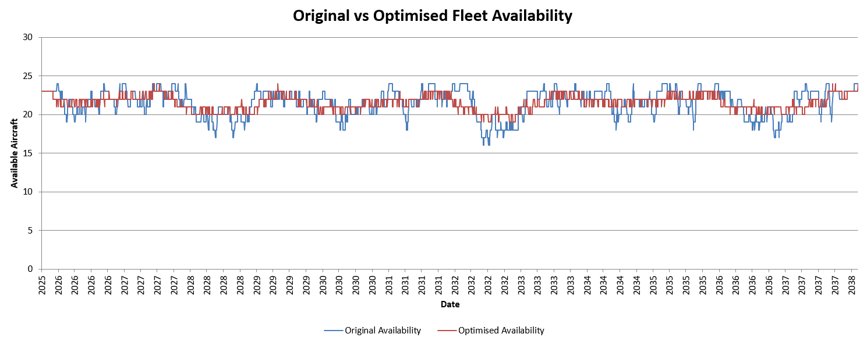
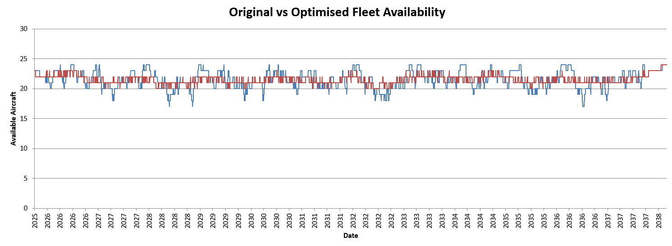
CONTROLLED START SCHEDULES
Moderate and Wide Staggers
Moderate initial stagger
Wide initial stagger

Slide 13
HYPERPARAMETER RESULTS
Tuning improved smoothness on every forecast
Dataset | Initial worst day | Tuned worst day | Default std | Tuned std | Results
Original | 15 | 18 | 1.4221 | 1.4019 | 1.42%
Moderate | 16 | 19 | 0.9117 | 0.8834 | 3.1%
Wide | 17 | 20 | 0.6167 | 0.5868 | 4.85%
Smoothness improvement at the same worst day: 1.42%, 3.10% and 4.85%
So far, best step sizes are 56, 42, 28, 14, 7, 3, 1

Slide 14
FINAL RECOMMENDATION
Final method: Priority Based Selection with VNS
METHOD
SHARED STEP SIZES
Priority Based Selection
with VNS
±56, ±42, ±28, ±14,
±7, ±3, ±1 days
Project outcome
Raised original worst-day availability from 15 to 18.
Simulated Annealing offered too little smoothness gain for its runtime.
Priority Based Selection with VNS was the best algorithm for computation time and solution
The Initial stagger is the deciding factor because it is not possible to improve it anymore with initial heavy schedule.

